Slide 1
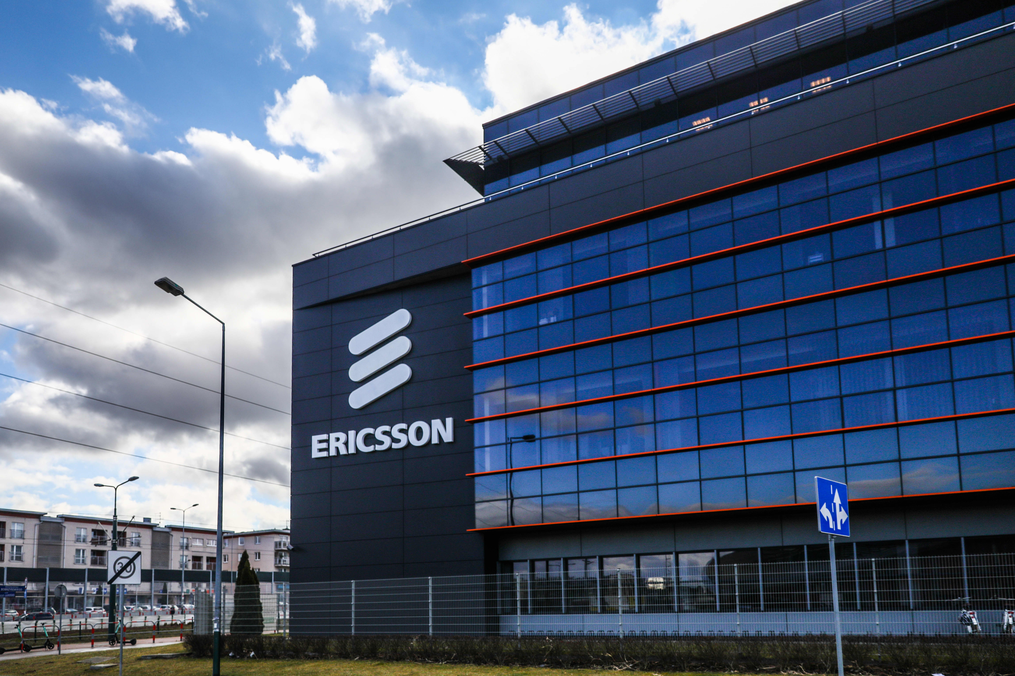
Designing Innovation: The Ericsson Journey
Created By Praneet

Slide 2
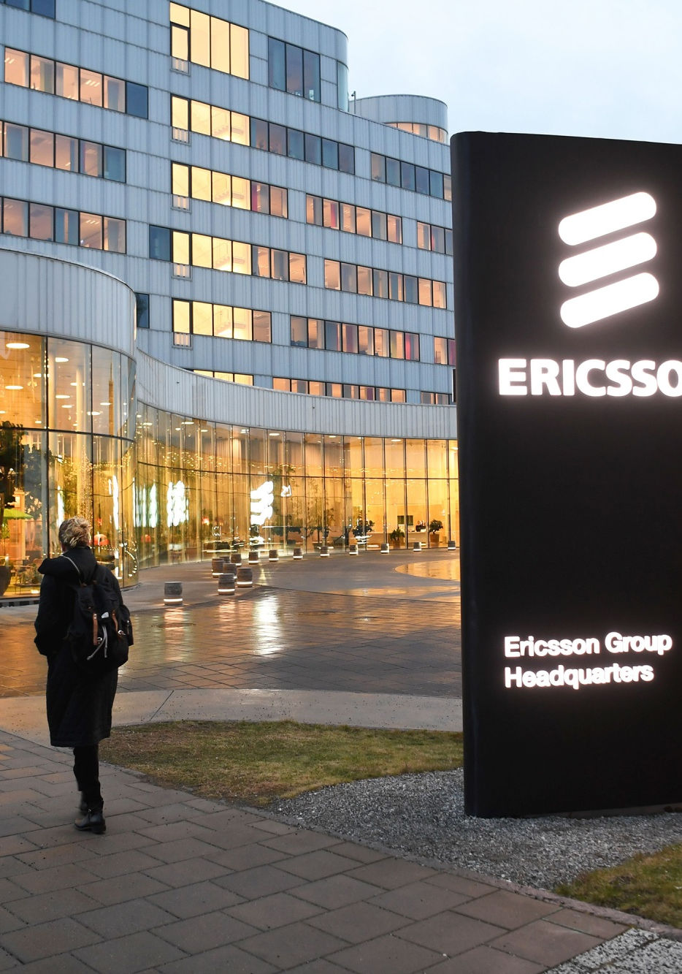
Contents
Introduction
Ericsson's Innovation Journey
Design Thinking in Innovation
Case Study: Ericsson's 5G Innovation
Conclusion

Slide 3
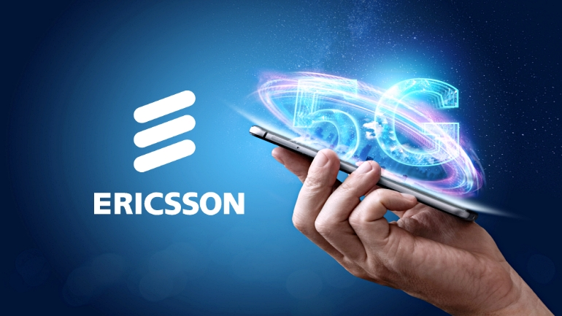

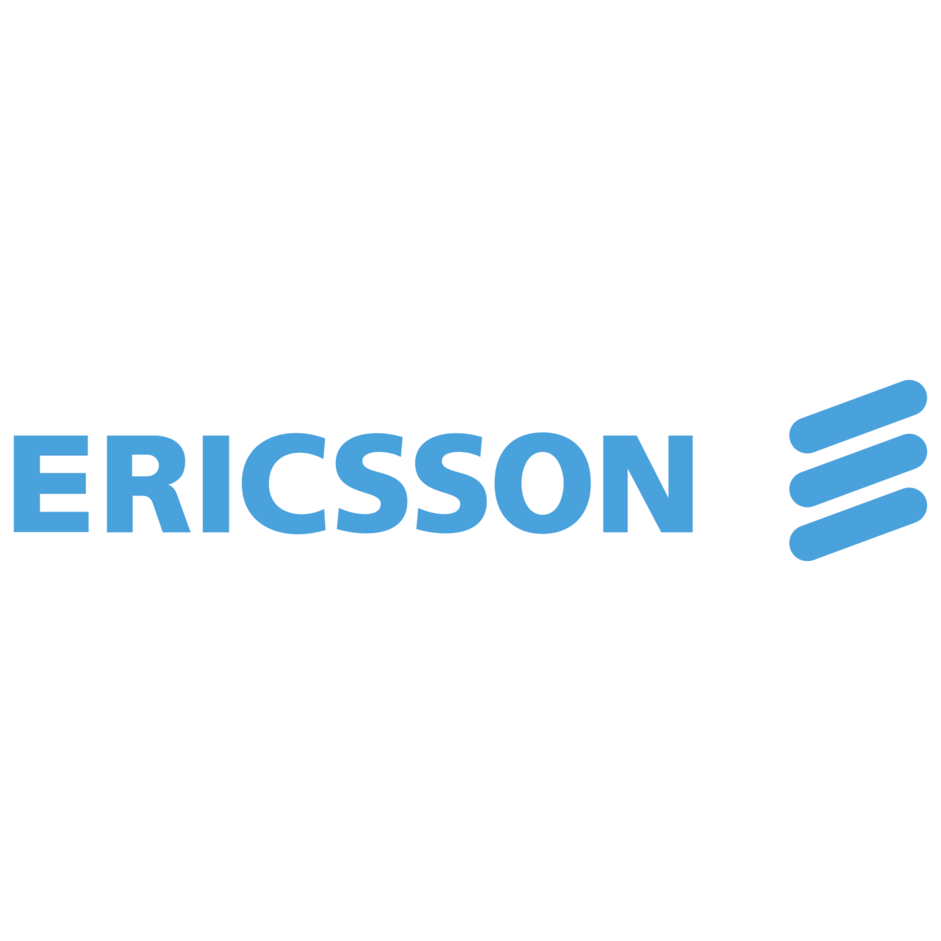
Introduction
Innovation is the lifeblood of progress, and Ericsson is a company that is constantly pushing the boundaries of what is possible. Design thinking has played a pivotal role in shaping Ericsson's innovation journey, helping the company to develop a wide range of innovative products and services that meet the needs of its customers and drive positive change in the world.
In this presentation, we will take a deep dive into Ericsson's innovation journey and explore the power of design thinking. We will discuss how Ericsson has used design thinking to develop innovative solutions in areas such as 5G, artificial intelligence, and the Internet of Things. We will also discuss the impact of Ericsson's innovation on its customers, employees, and the world at large.
I invite you to open your minds and embrace the possibilities that lie ahead as we embark on this journey together.

Slide 4
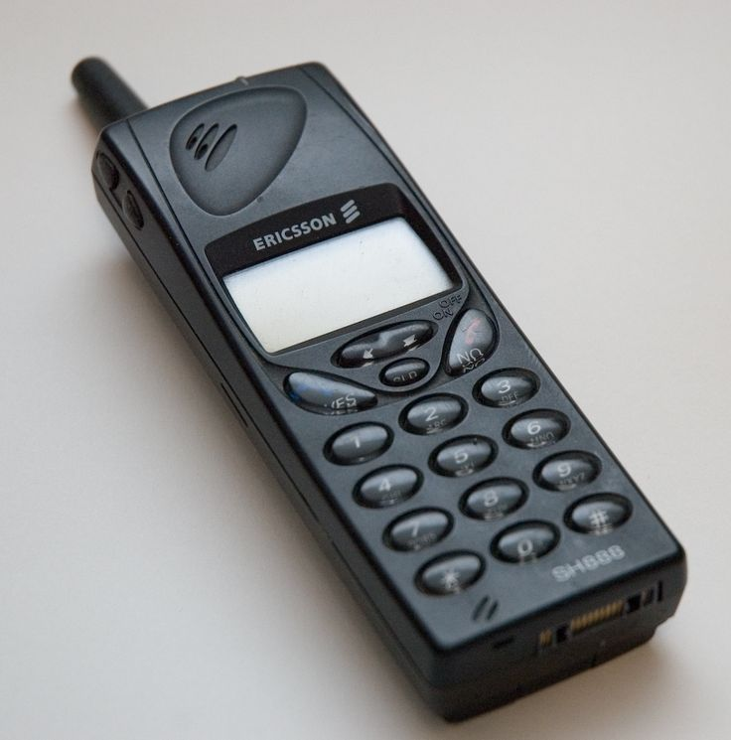
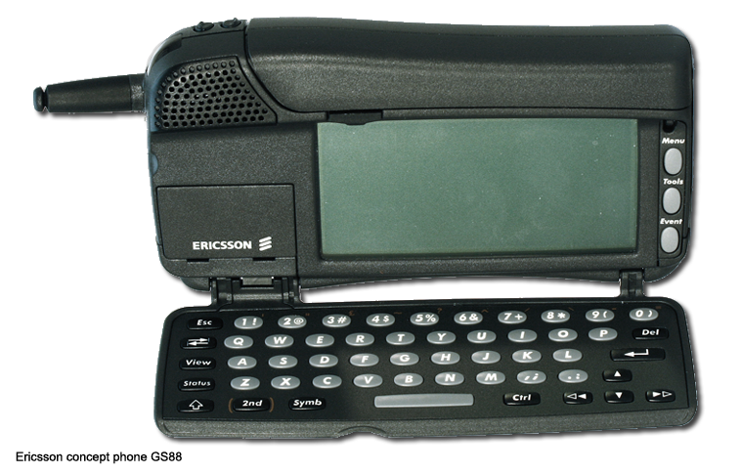
Ericsson's Innovation Journey
Ericsson has a long and distinguished history of innovation, dating back to its founding in 1876. The company has been responsible for numerous groundbreaking inventions, including the first automatic telephone exchange, the world's first mobile telephony system, and the first commercially available LTE network.
One of the keys to Ericsson's success has been its ability to stay ahead of the curve when it comes to emerging technologies. From the early days of telephony to the present day, the company has consistently demonstrated a willingness to take risks and invest in new ideas. This approach has enabled Ericsson to maintain its position as a leader in the telecommunications industry, even as the landscape has shifted dramatically over the years.
Ericsson's commitment to innovation is evident in its portfolio of products and services, which spans a wide range of technologies, including 5G, artificial intelligence, and the Internet of Things. The company is also a major player in the development of new standards and protocols that will shape the future of telecommunications.
Ericsson's innovation is not only beneficial to its customers and shareholders, but it also has a positive impact on the world at large. The company's technologies are helping to connect people, businesses, and machines in new and innovative ways, and they are also enabling new applications and services that are improving the lives of people around the globe.

Slide 5
Case Study: Ericsson's 5G Innovation
Ericsson's journey towards 5G innovation began with a clear understanding of the market needs and customer pain points.
By using design thinking, Ericsson was able to identify the key challenges and opportunities in the industry and develop solutions that met the needs of their customers.
Through a series of iterative design sprints, Ericsson was able to rapidly prototype and test their ideas, refining them based on customer feedback and market insights.
This approach allowed them to quickly identify the most promising solutions and bring them to market faster than their competitors.

Slide 6
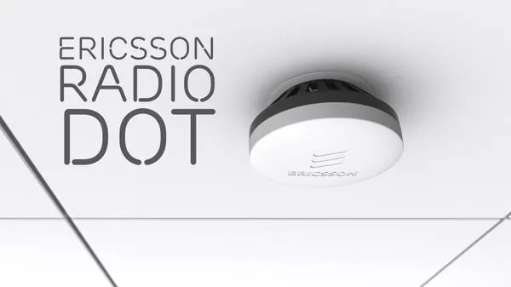
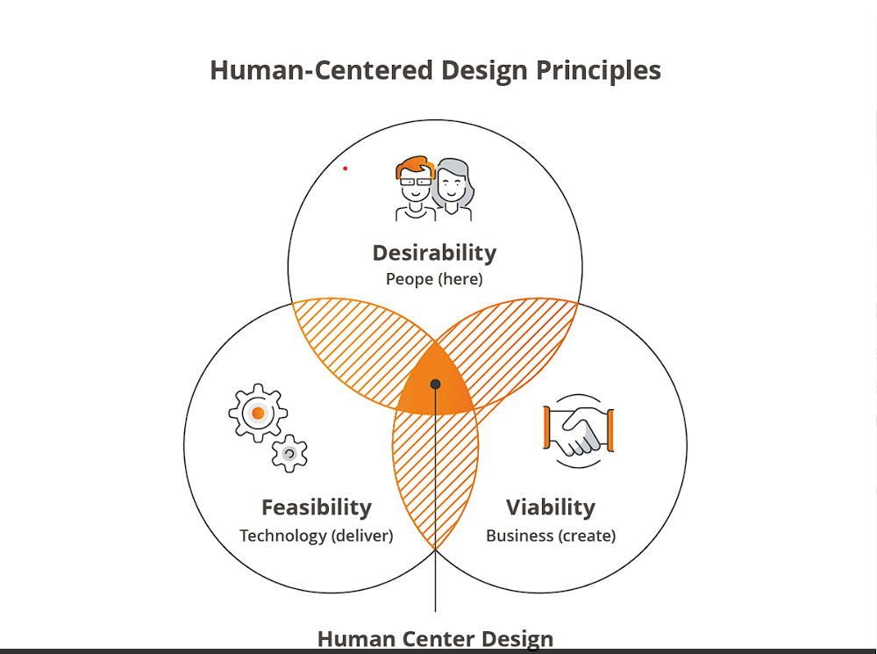
Design Thinking Innovation in Ericsson
Design thinking is a problem-solving approach that has been crucial to Ericsson's innovation journey. By putting the user at the center of the solution, Ericsson has been able to create products and services that meet customer needs and exceed their expectations.
One example of how design thinking has contributed to Ericsson's innovation journey is the development of the Ericsson Radio Dot System. This small cell solution was designed with the end-user in mind, making it easy to install and use. The product was developed through close collaboration between Ericsson and its customers, resulting in a solution that met their specific needs and improved their overall experience.
Ericsson's use of design thinking is a testament to the company's commitment to innovation and customer satisfaction. By taking a human-centered approach to product development, Ericsson is able to create solutions that truly make a difference in the lives of its customers.
.

Slide 7
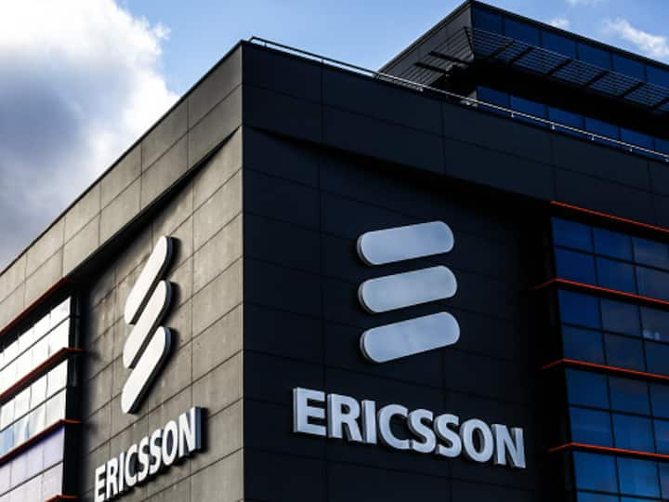
Conclusion
In conclusion, Ericsson's innovation journey has been marked by a commitment to design thinking and a willingness to embrace new technologies. By leveraging design thinking principles, Ericsson has been able to develop groundbreaking products like 5G technology, which will shape the future of communication. In addition, Ericsson's focus on collaboration, both internally and with external partners, has been instrumental in driving innovation and achieving success.
As we look to the future, it is clear that innovation will continue to be a key driver of growth and success. By embracing design thinking and fostering a culture of collaboration and experimentation, companies like Ericsson can stay ahead of the curve and continue to deliver innovative solutions that meet the evolving needs of their customers.

Slide 8
Thank you
DESIGNED & CREATED BY PRANEET

